Slide 1
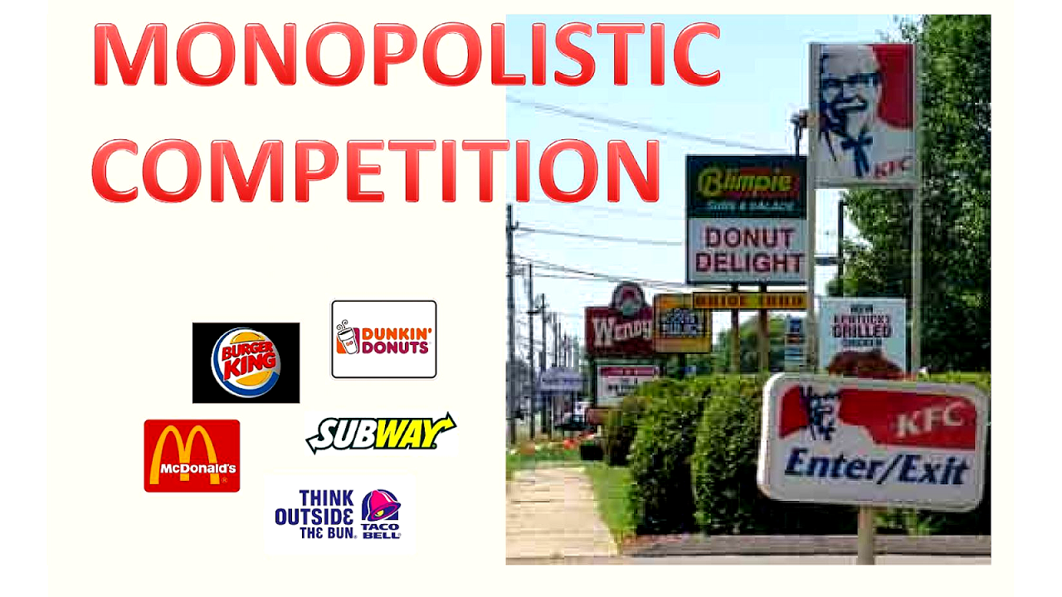

Slide 2
Features of Monopolistic competition
Large number of sellers
Differentiated product or Product Differentiation
Low barriers to entry and exit
Shares the features of both monopoly and perfect competition

Slide 3
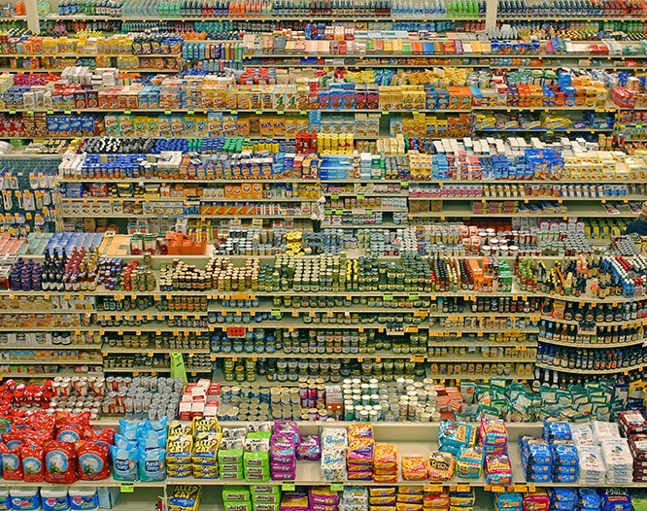
Examples of Monopolistic competition
Consumer products
Clothes
Footwear
Watches
Sportswear
Restaurants
Mobile

Slide 4
Product Differentiation
Style or type
Location
Quality

Slide 5
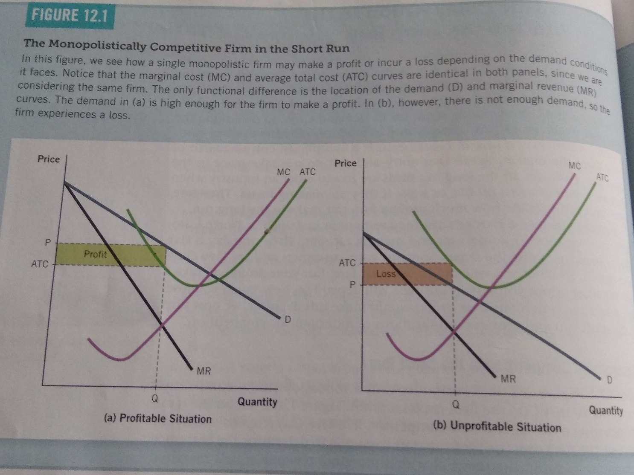
Monopolistic competition in the short run
It faces downward sloping demand curve.
Profit maximization rule ,produces the output Q at MC= MR.
Panel A P > ATC makes positive economic profit.
Panel B P< ATC makes negative economic profit.

Slide 6
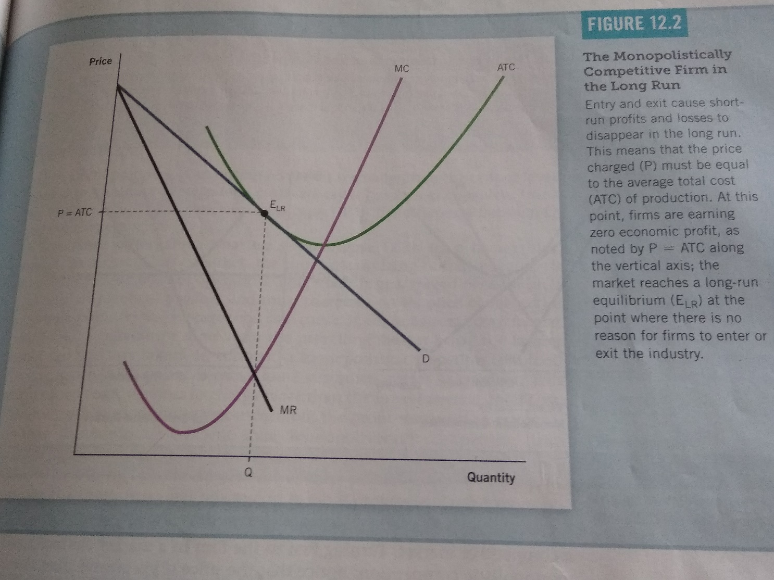
Monopolistic competition in the long run equilibrium
Demand curve in this figure is tangent to the average total cost curve.
Making zero economic profit
Tangency occurs at the same point where MC = MR
As in monopoly P>MC
As in competitive market P = ATC. This conclusion arises because free entry and exit drive economic profit to zero.

Slide 7
Monopolistic competition versus perfect competition
Monopolistic competition
Perfect competition
Under monopolistic competition firms produce on downward sloping portion of average total cost curves.
The quantity the minimizes average total cost is called efficient scale output of the firm.
Monopolistic competitive firm produces less than efficient scale output.
Firms have excess capacity under monopolistic competition.
P > Marginal Cost Mark Up pricing
Under perfect competition firms produce at the minimum of average total cost curves.
Perfect competitive firm produces efficient scale output.
P = Marginal Cost

Slide 8
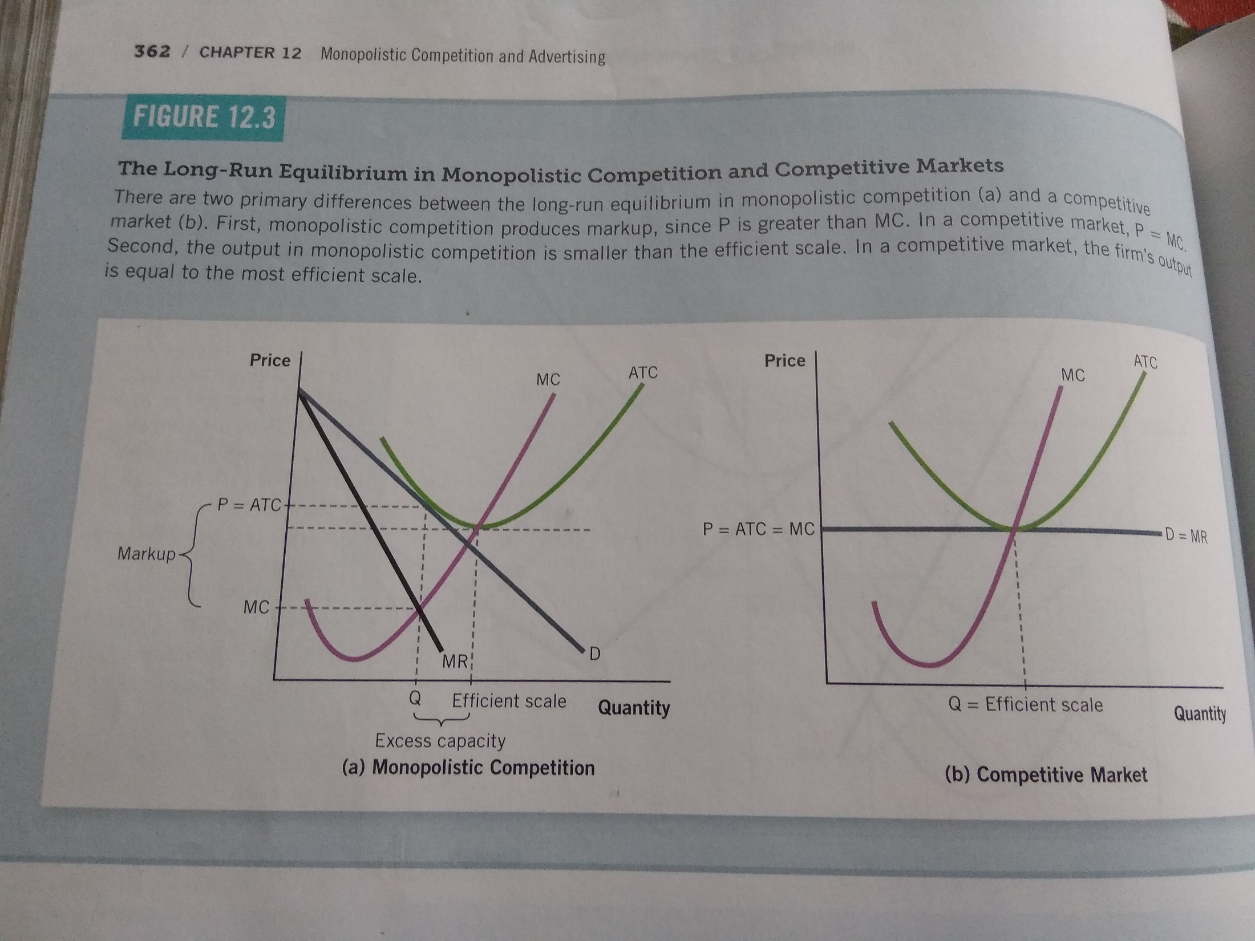

Slide 9
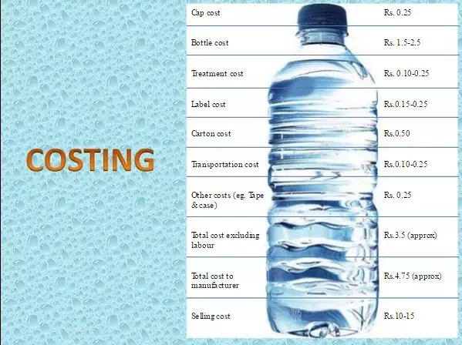
Mark Up pricing for mineral water
Mark Up pricing is the difference between the firm charges and the marginal cost of production.

